Slide 1
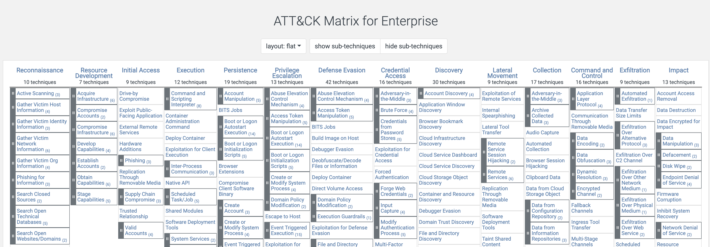
MITRE ATT&CK
https://attack.mitre.org/
Today we will be looking at persistence.

Slide 2
Persistence

Slide 3

Establishing Persistence
Attackers want to develop that staying power.
After all, they worked hard to gain access to that system (maybe). They do not want to lose it the moment the system reboots or a password gets reset.
The name of the game for the adversary is to have a persistent foothold that will let them come back, whenever they have the inclination.
This Photo by Unknown Author is licensed under CC BY-SA

Slide 4
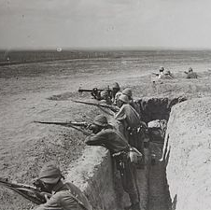
Examples of Methods for Establishing Persistence
Create or manipulate an account.
Scheduled task or job.
Scripts or programs to run at boot or logon.
Browser extensions.
Modify authentication processes or flows.
Implant cloud container with malicious code/functionality.
This Photo by Unknown Author is licensed under CC BY-SA

